Slide 1
AI/ML Application on E-Commerece to Design an Effective Recommendation System Amir Meimand, Director of R&D

Slide 2
Artificial Intelligence – A Definition for B2B
The capability of a machine to imitate intelligent human behavior
Sales Person
Pricer
…could evaluate every customer relationship, every day and recommend action?
What if your best…
Buyer
Product Manager
Financial Analyst
How would that impact your revenue, profit and margin?

Slide 3
Zilliant IQ - Overview
IQ ENGINES
AI & Prescriptive Insights
IQ MANAGER
Map Strategy to Execution across all channels
ACTION IQ
Drive Sales & Pricing Actions
IQ ANYWHERE
Omnichannel Activation
INSIGHTS
INITIATIVES
ACTIONS
EXECUTION
Notes:
New capability to highlight…..IQ Manager
Think of it as a cockpit or command center for execs and managers to drive their Strategy across the Enterprise

Slide 4
Zilliant IQ – Product Packaging
Zilliant IQ – Multi-Tenant SaaS Platform
Omnichannel
Activation
Ex. Data Ingestion
IQ Anywhere – Integration & Omnichannel Activation
Email
Product Master
IQ Anywhere
Mobile
Zilliant Apps.
Customer Master
Action IQ - Actionable Intelligence & Sales Guidance
Minimum Data
Account IQ
Deal IQ
Browser
Transaction Data
CRM / CPQ
IQ Manager - Drive Strategy Through the Organization
IQ Manager
eComm
Win / Loss Data
Enterprise Integration…
IQ Engines - AI & Prescriptive & On-Demand Insights
Quoting Tools
3rd Party Data
Optional Data…
Price IQ
Sales IQ
Cart IQ
Cost IQ
Profit IQ
Prospect Data
ERP
Cloud Infrastructure: Highly Scalable – Secure – AI/ML – In-Memory Reporting
Notes:
Action IQ is the family: shared capabilities + unique

Slide 5
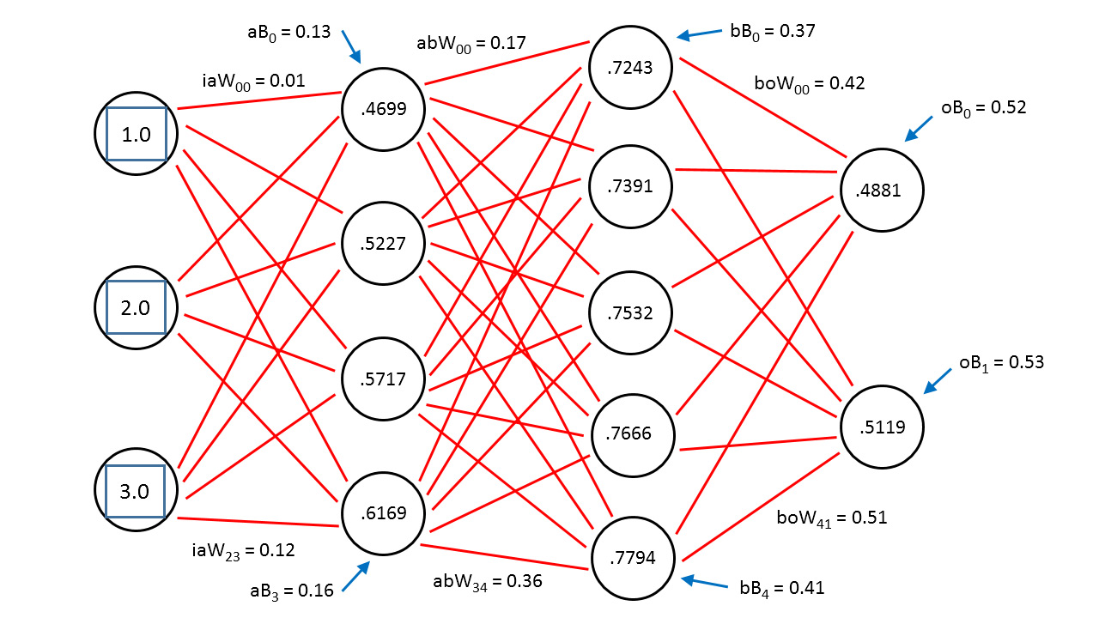
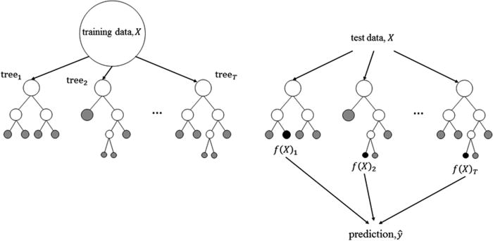
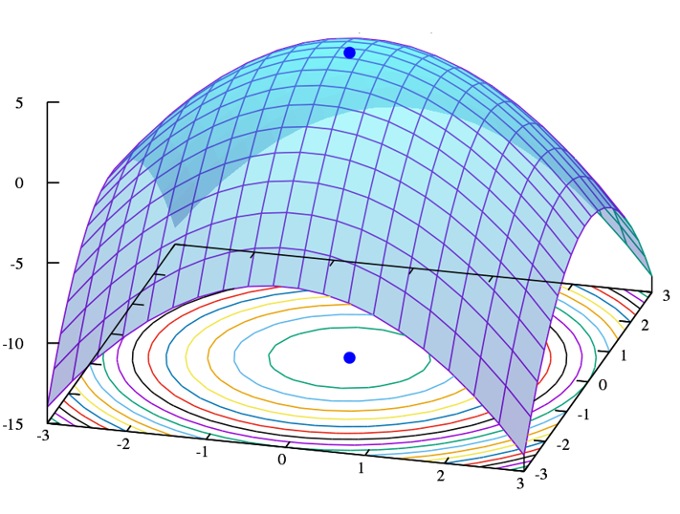
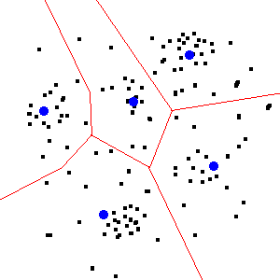
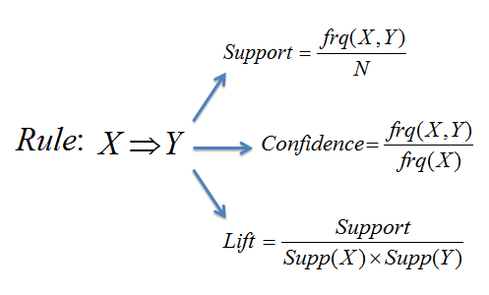
The Zilliant IQ Platform Brings Best-In-Class AI to B2B
Random Forest
Neural Network / Deep Learning
Convex Optimization
Clustering
Association Rules

Slide 6
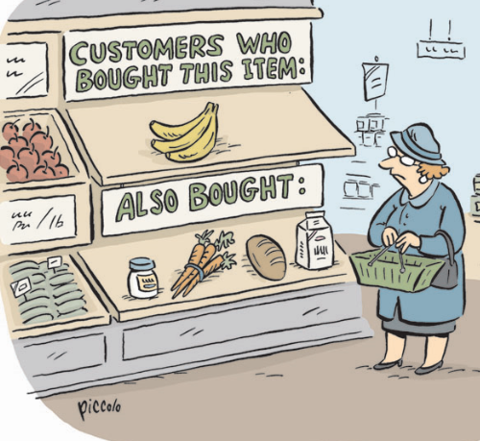
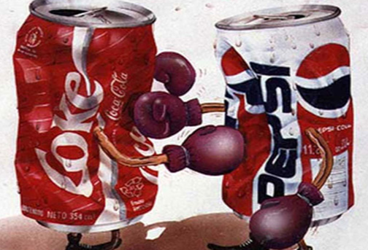
Complementary vs Substitute Products
Complementary Products: The products that are mostly purchased together
Substitute Products: The products that can be used instead of another.
Milk
Butter
Coca Cola
Pepsi

Slide 7


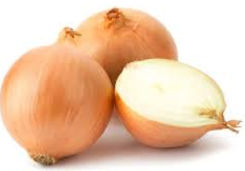
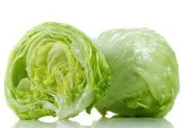
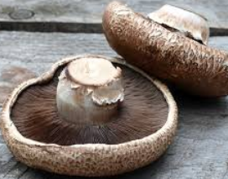
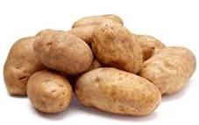
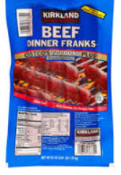
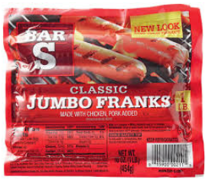
Importance of Complementary and Substitute Product
Cross-sell/Upsell
Product Mixed Effect
Price
Product

Slide 8
Association Rule Concept
Items
 | I1 | I2 | I3 | I4 | I5
B1 | 1 | 0 | 1 | 1 | 0
B2 | 0 | 0 | 1 | 0 | 1
B3 | 1 | 1 | 0 | 1 | 0
B4 | 0 | 0 | 0 | 1 | 1
B5 | 0 | 1 | 0 | 1 | 0
Metric can be interpreted as
the conditional probability or purchase
Baskets
1 if item was purchased in the basket, 0 if not purchased.

Slide 9
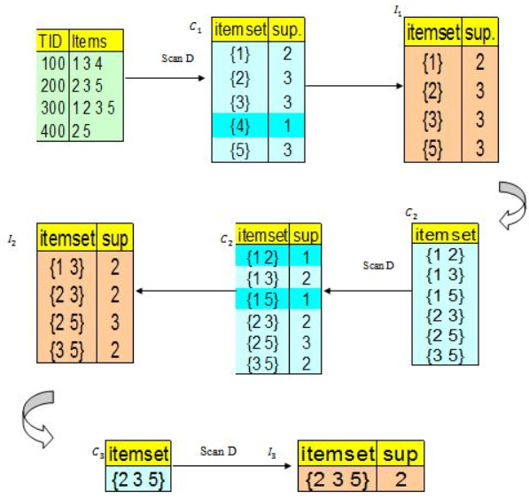
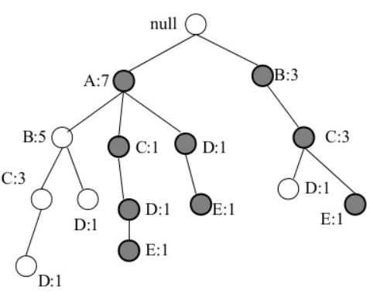
Association Rule Algorithms
Apriori : uses a breadth-first search strategy to count the support
of itemset and uses a candidate generation function which exploits the
downward closure property of support.
FP-Growth: first counts occurrence of items (attribute-value pairs)
in the dataset, and stores them to 'header table’. then builds the FP-tree
structure by inserting instances. Items in each instance have to be sorted
by descending order of their frequency in the dataset, so that the tree can
be processed quickly.

Slide 10
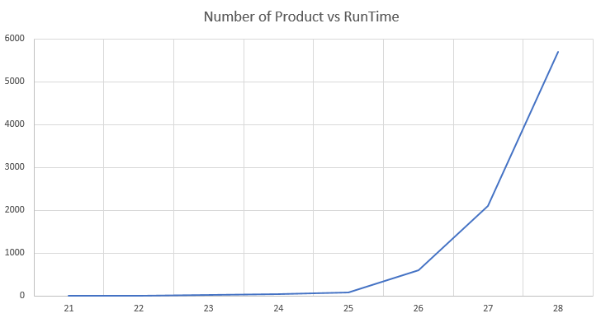
Association Rules Mining Complexity
Running time is studied in two dimension:
Fix number of item per orders: Running time increases linearly by orders
One Order with different number of products: Running time increases exponentially by products:
Run time in second
Number of products

Slide 11
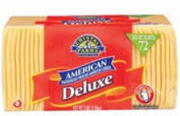
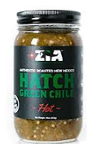

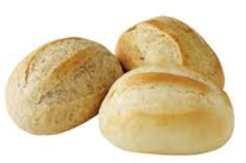
Substitute Mining
Complementary of
Complementary of
Items bought in similar baskets, but rarely together.

Slide 12
B2B eCommerce Trends & Challenges
Growing Population of Digital Buyers
Born in the Cloud & Non –Traditional Competitors
Increasing
Amazon Bringing Personalized Purchasing experience to B2B
Traditional Competitors adopting eCommerce ahead of you
“Make it easy for me to do business with you”
“I don’t want to talk to a sales person”
How do I move my catalog online?
How can I get a simple quote for a customer without a sales touch and lead time?
Should I show the same prices to new customers versus tenured customers?
Customer loyalty needs to increase with the online experience
My eCommerce experience right now is an order entry system with static prices and without nimble, intelligent recommendations
How long will it take for eCommerce to reduce the cost of doing business?

Slide 13

Go-To-Market with A Frictionless eCommerce Experience
Offer Items On Contract
Personalized recommendations for items Off Contract
Complementary Item Recommendations
Log in Functionality
Relevant Pricing for Guests versus Customers
Pricing that reflects off-line sales discussions

Slide 14
Example of a Frictionless Experience

Slide 15
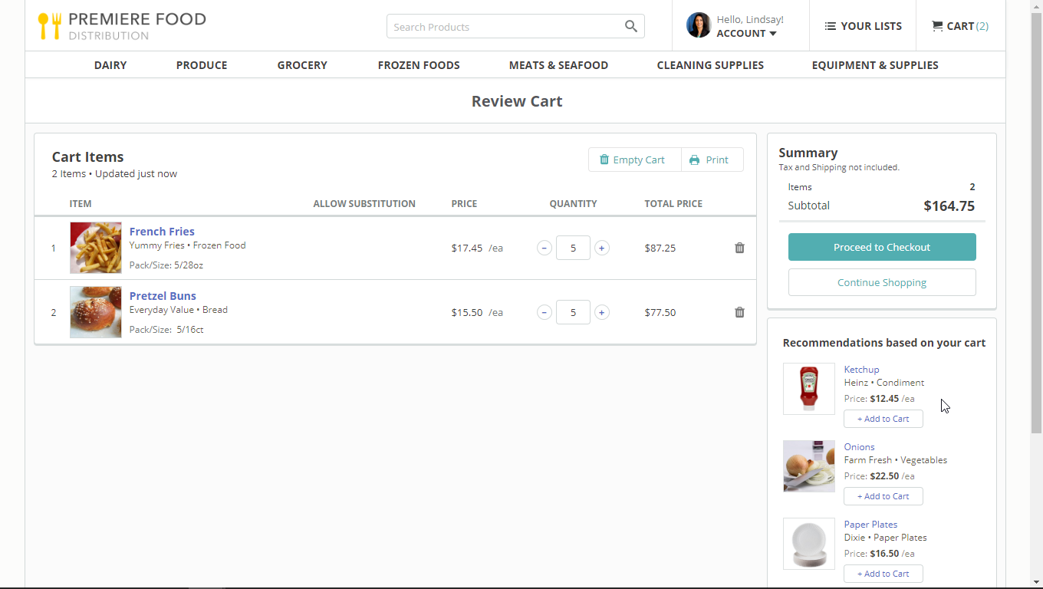
Complementary Product Recommendations based on Items in Cart

Slide 16
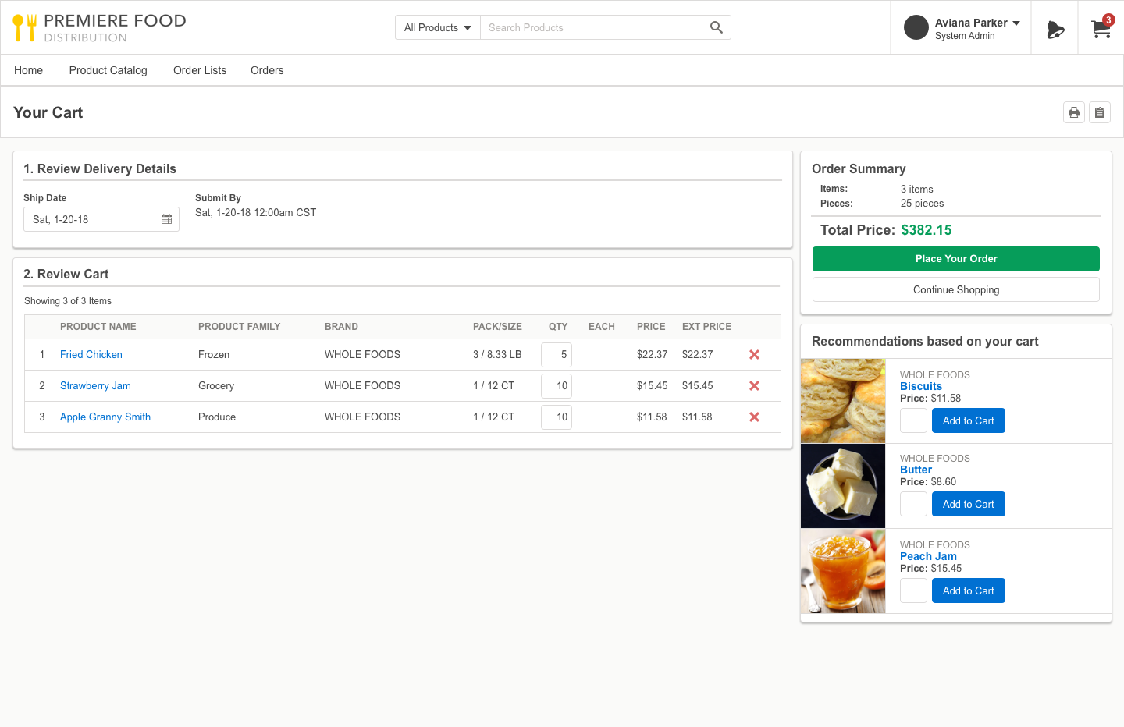
Cart IQ in Action Increase Order Size with Most Likely Cross Sell Items

Slide 17
Thank You!

